Slide 1

Natural language processing
Lecture 7: Transformers (BERT)
Roberta Rocca
Assistant Professor, IMC & CHC
✉️ roberta.rocca@cas.au.dk
Notes:
A “fractal” view on word2vec, where we start from the overall intuition, and we dive increasingly deeper into the architecture

Slide 2
Exercise
Try to reconstruct *in broad strokes* what a model doing language modeling with attention looks like and how it works.
Try to explain: which computations attention involves, which purpose it serves, and what the overall logic is.
Notes:
Mention key, query, value

Slide 3
Recap: the bigger picture
Remember: our fundamental question is that of identifying computational methods and architectures that make it possible to represent language quantitatively
We want our representations to reflect fundamental aspects of meaning (e.g., similarity relations)
We want our representations to be good inputs for models that perform downstream linguistic tasks (from labelling and classifying text, to complex tasks like question answering)
There are two angles to this:
Scientific questions: what does it take to build a system that can encode and operate on language? And how will these differ from our way of processing and encoding language?
Applied aspect: Real-world applications of these technologies
Notes:
Both intelligence

Slide 4
Recap: we started from static encodings
The “distributional hypothesis” (you can know a word by the company it keeps) is a convenient theoretical paradigm for NLP
First breakthroughs: count-based and “static” predictive models (Word2Vec). Words are vectors resulting from more (predicting) or less (counting) sophisticated ways to encode the distribution of contexts a word tends to occur in
Interestingly, these vectors have geometrical properties that reflect dimensions of meaning (e.g., similar words -> close-by vectors)
Unfortunately, these methods ignore some pretty important aspects of meaning, i.e., the role of word order and context-dependencies
Notes:
Both intelligence

Slide 5
Recap: then we introduced recurrence
RNNs and LSTMs offer a solution to this!
These are architectures where the same computations are applied sequentially to each bit of the input: by doing so, they build cumulative representations of sequences (hidden states) which are sensitive to order
With these, we can do language modeling (predict the next word), which is a great way to learn representations of language, as it hinges on semantic & syntactic knowledge
Unfortunately, these architectures are subject to the information bottleneck. There is only so much information that can be packed into a hidden state
This is not convenient for sequential tasks where dynamically accessing specific information on different parts of the input may be important (e.g., machine translation, language modeling, etc)
Notes:
Both intelligence

Slide 6
Recap: dynamic encodings with attention
Meet attention!
Attention is a mechanism that allows models to access representations of each token in a dynamic way
Representations for token t are a function of a static representation of this token, and a weighted sum of representations for all other tokens
Weights are computed through simple dot products (though there are more sophisticated functions)
This yields contextualized representations of the token t which dynamically encode information about the rest of the sequence (and eliminate the need for recurrence)
The resulting representations are much better for downstream tasks (e.g., MT, LM)
Notes:
Both intelligence

Slide 7
Today’s plan
Self-attention in transformers
What else is included in a transformer architecture?
BERT: training tasks, transfer learning, and applications
Interpreting BERT: some examples from the BERTology
Notes:
Both intelligence

Slide 8
How does self-attention work in a transformer?
We want to use self-attention to produce a representation of token t which also includes information about all other elements in the sequence (without using recurrence)
Take t as input
Convert it to a vector
Compare it to all other tokens in the sequence
Produce a new, contextualized representation of t (output)
We want to do this for all tokens simultaneously
Notes:
Machine translation is not trivial

Slide 9
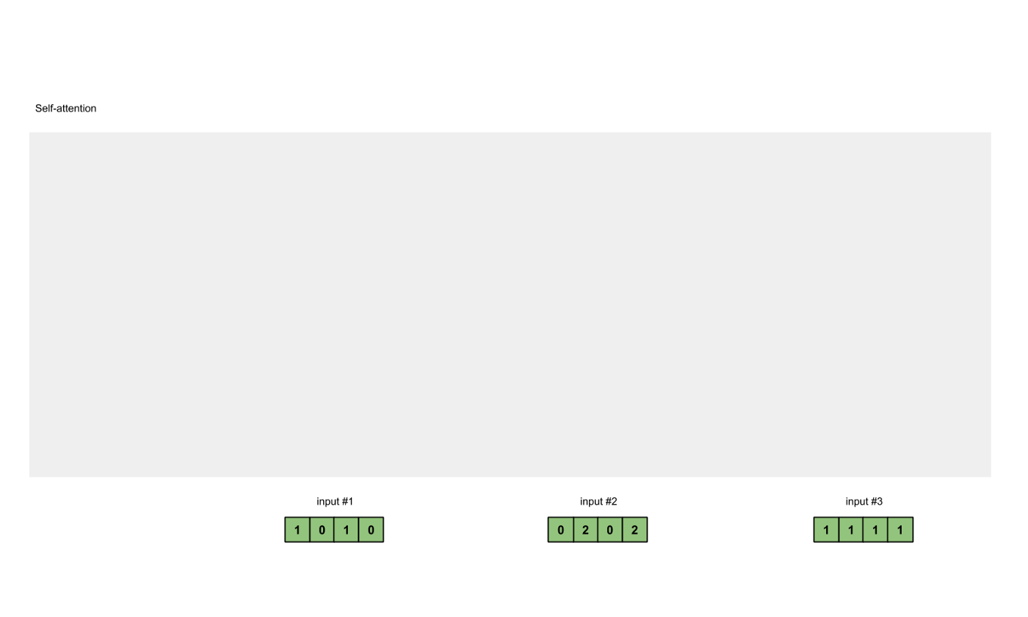
Initialize input
The first thing we do is that we initialize each of our input as a embedding vectors
In this example, we use 3 inputs
(i.e., three words) whose initial embedding has dimensionality 4
Input 1 = [1, 0, 1, 0]
Input 2 = [0, 2, 0, 2]
Input 3 = [1, 1, 1, 1]
This is just a word embedding

Slide 10
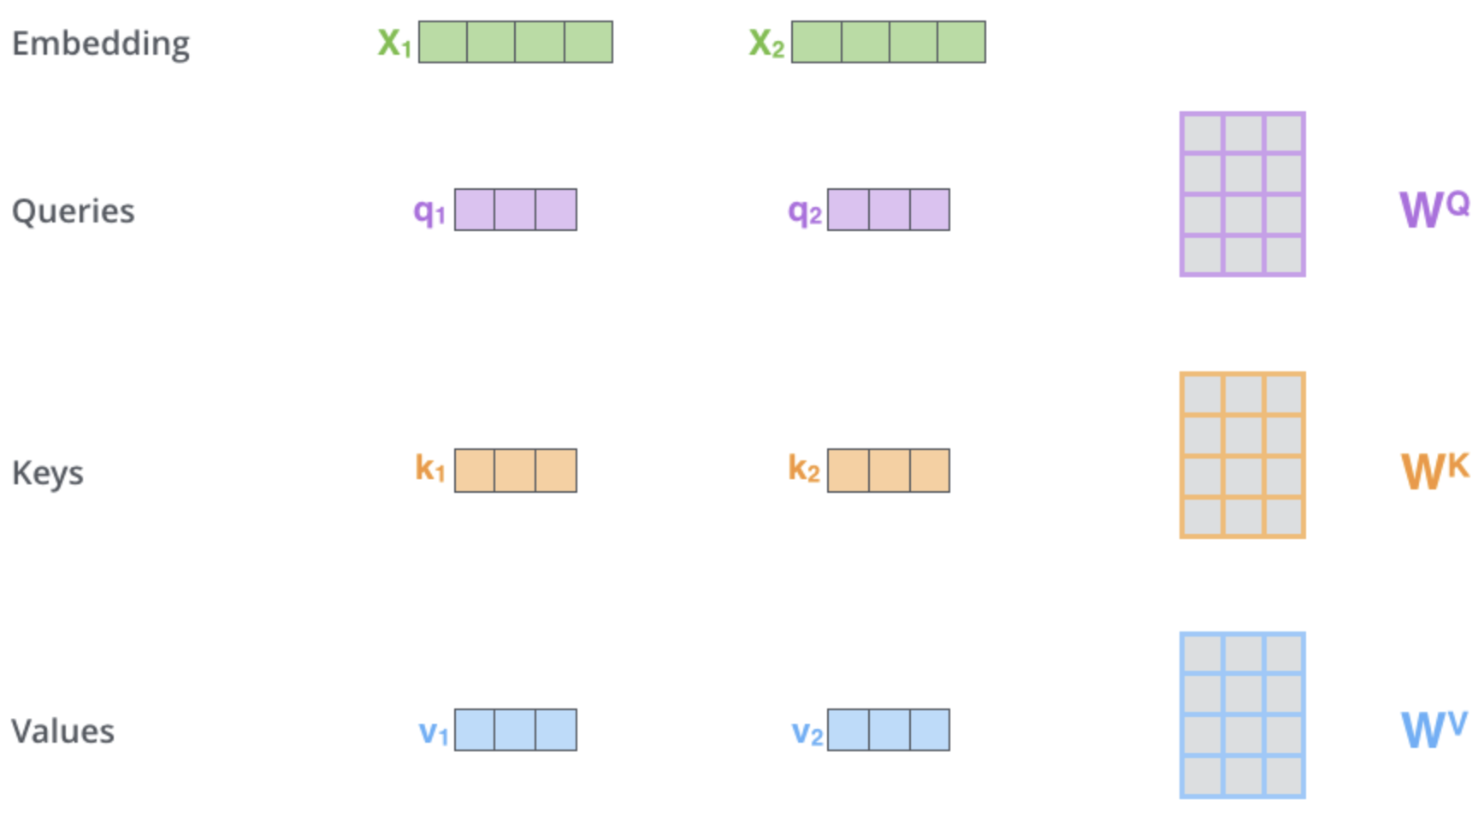
2. Transform input into key, query, value
The input is projected into three separate vectors: a query, a key, and a value
This is done by multiplying the input by a weight matrix (which can also alter, e.g., reduce, the dimensionality of the input)
We have three weight matrices (learnable parameters): Q, K, V
From Alammar (2018)

Slide 11
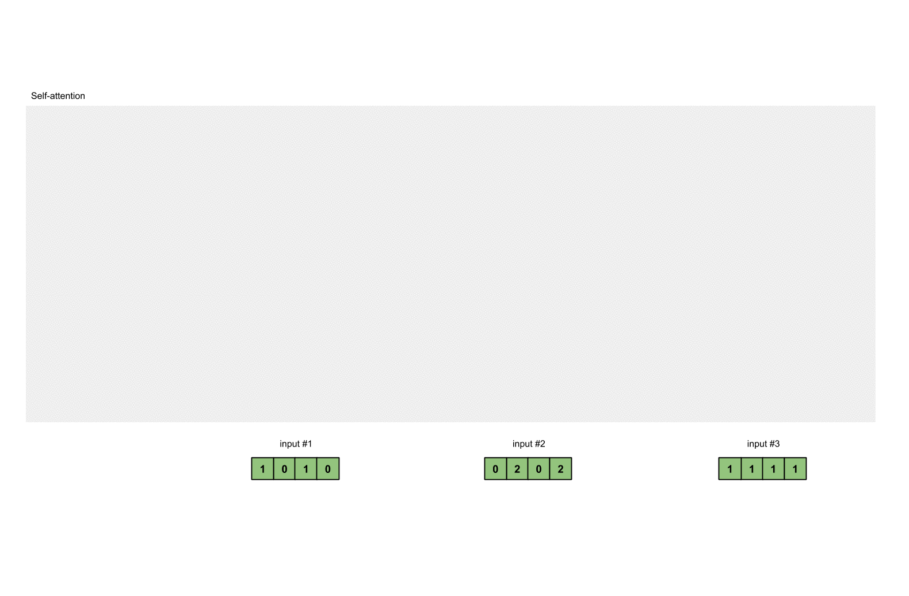
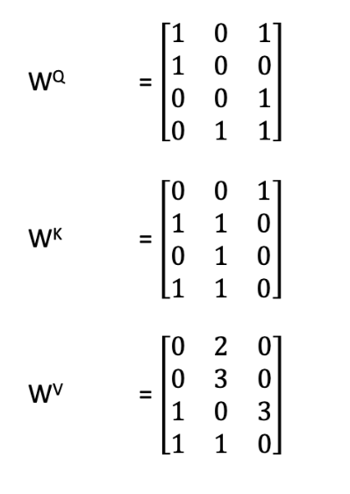
3. Get Q,K,V vectors
In this example, the weight matrices are
We do this for all tokens
From Karim (2019)

Slide 12
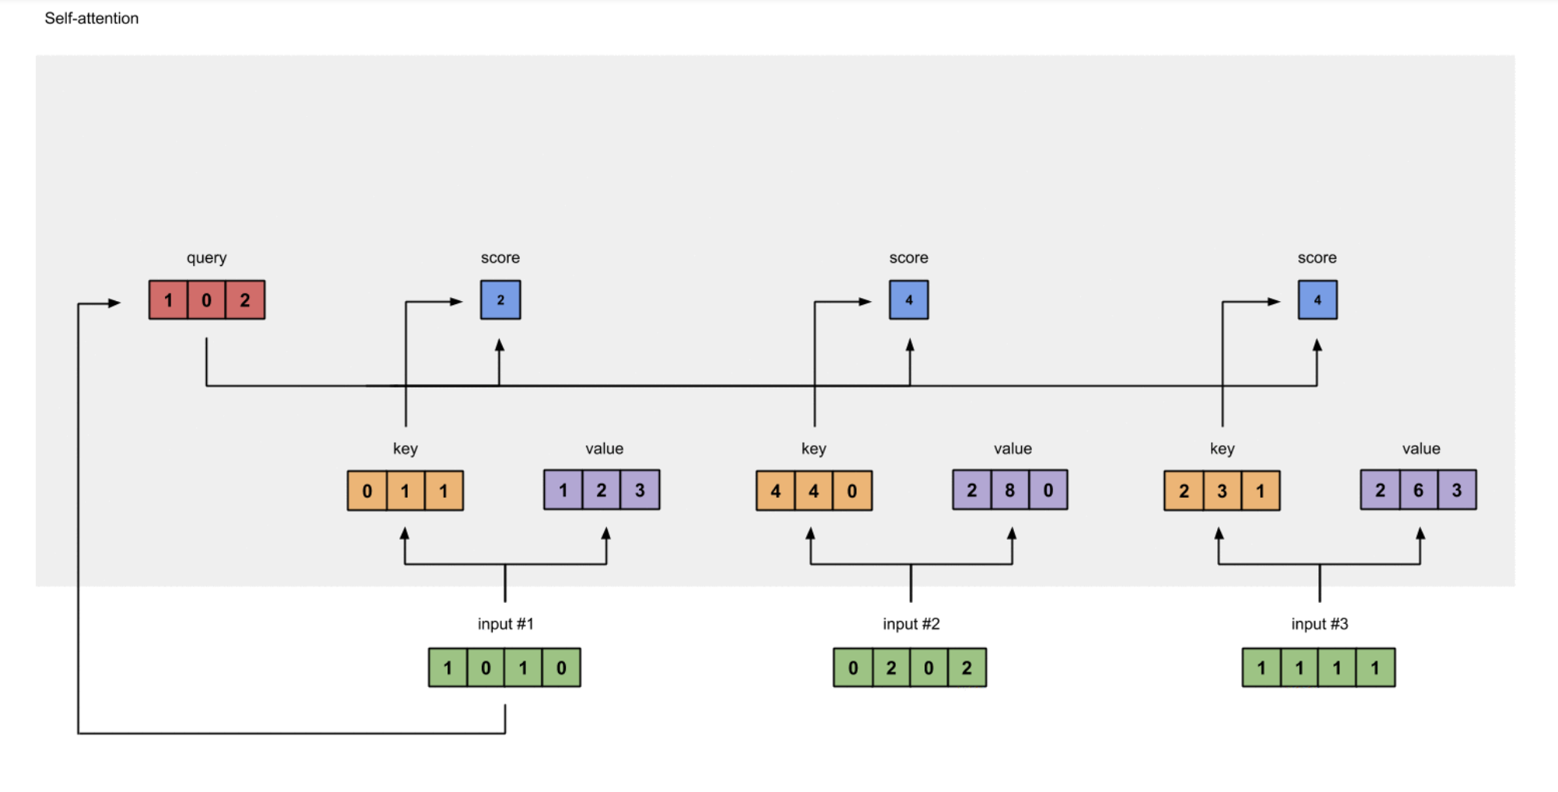
4. Calculate attention scores
To obtain attention scores, we simply take the dot product between the query from Input 1 (red) and all of the keys (orange)
Since there are 3 key representations, we obtain 3 attention scores (blue)
Notice how we get the dot product between the query and key for input 1, too
From Karim (2019)

Slide 13
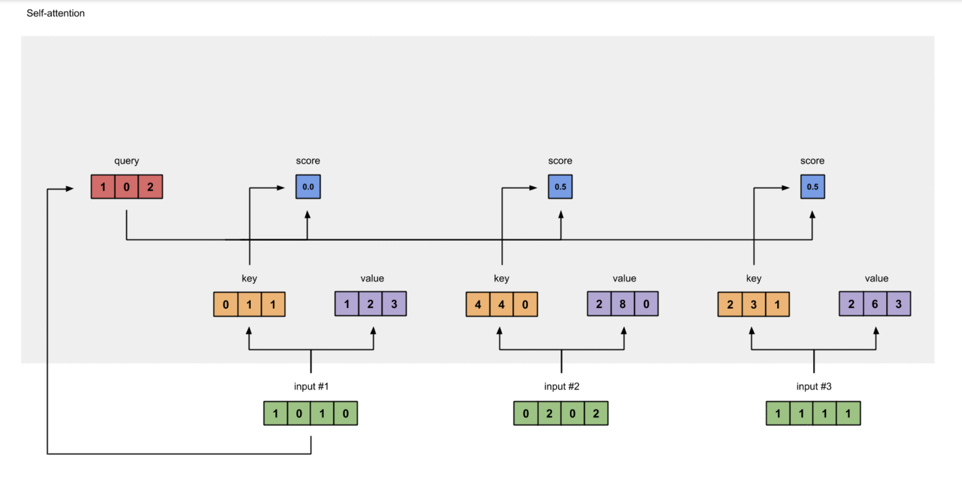
5. Softmax and multiply
We then run all of the scores through a softmax function
softmax([2,4,4]) = [0.0, 0.5, 0.5]
These are the attention weights, which we then multiply by the value vectors, creating weighted values
From Karim (2019)

Slide 14
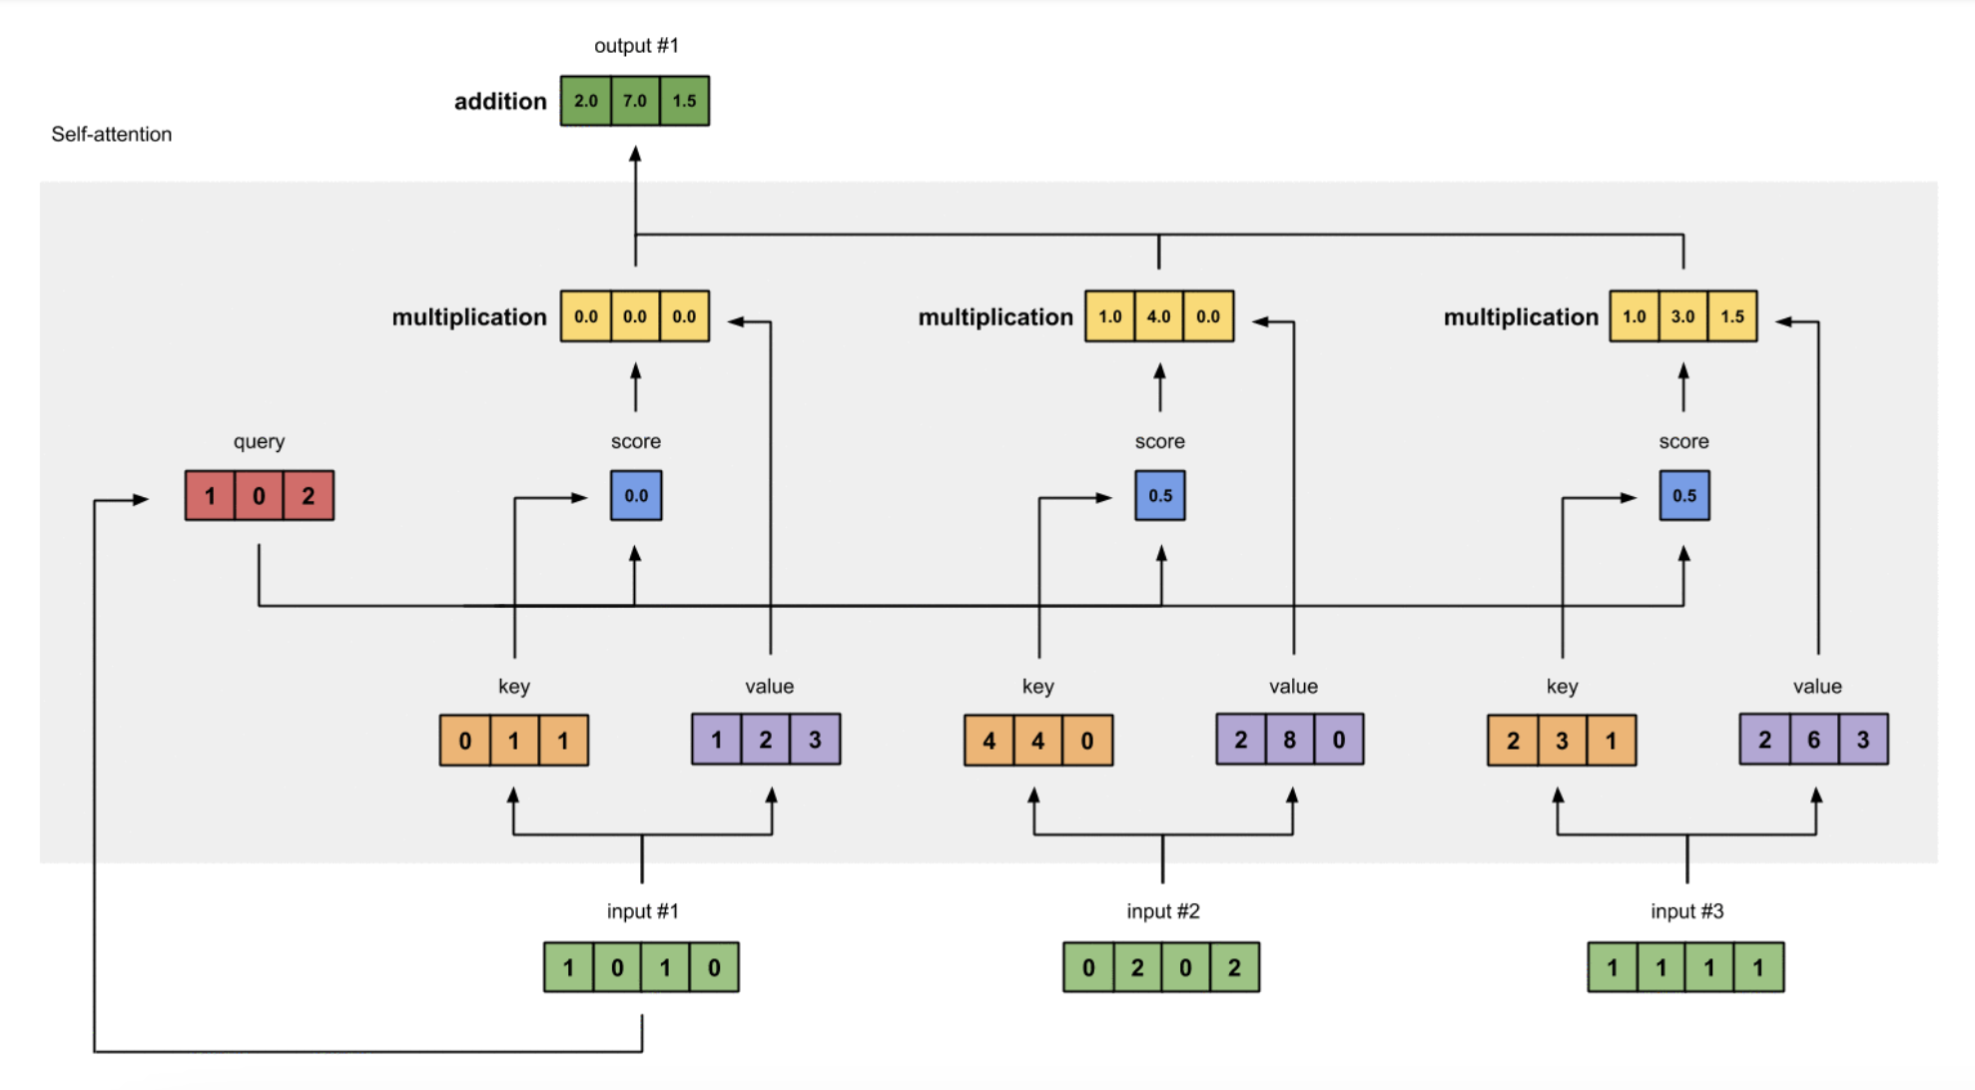
6. Sum weighted values
Lastly, we take all weighted values (yellow), and sum them element-wise
The resulting vector (dark green) is based on the query representation from Input 1, interacting with all other keys (including itself)
From Karim (2019)

Slide 15
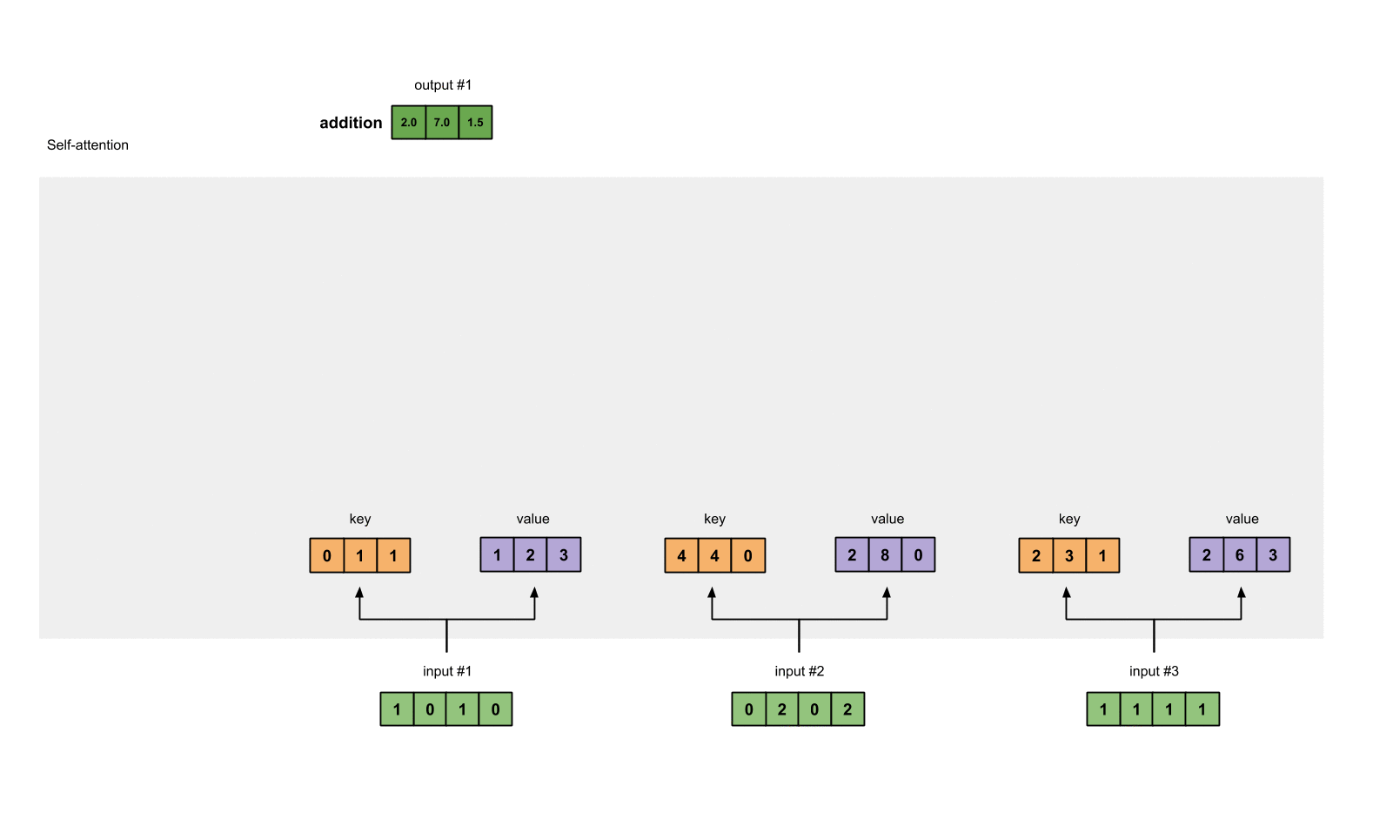
7. Repeat for remaining inputs
We then repeat the same steps for the subsequent inputs
So we’re using self-attention to learn contextualized output embeddings from our “static” inputs directly
No hidden states, no recurrence, same result: we are free!
From Karim (2019)

Slide 16
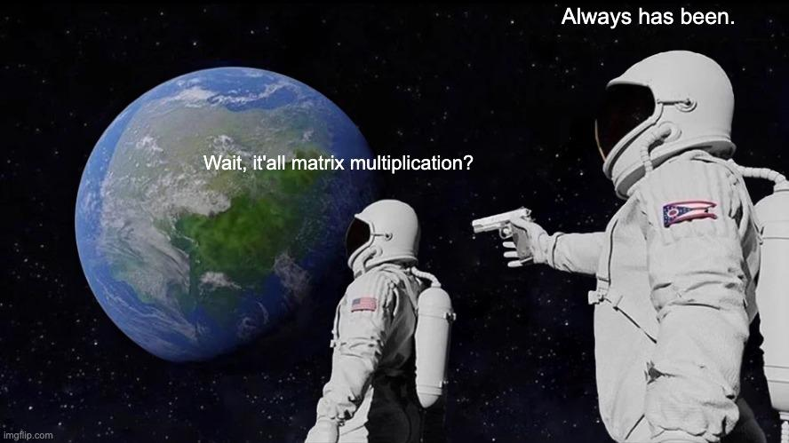
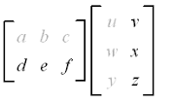
Notes:
Row x column -> then same row to same column (but go one further in the column matrix)
Softmax is applied across

Slide 17
Language modeling with self-attention
In practice, this happens simultaneously (matrices!)
Let X = [x₁; … ; x_{T}] be a matrix of input vectors (dimension: T x d)
Let K, Q, and V be the weight vectors, through which we project the input into key, query, and vector values
The output of a self-attention layer is:
Attention weights (T x T)
Notes:
Row x column -> then same row to same column (but go one further in the column matrix)
Softmax is applied across

Slide 18
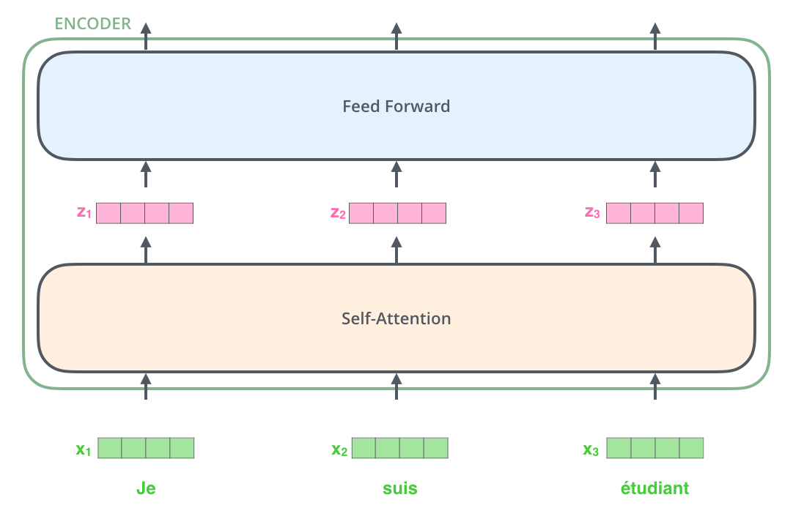
Inside a transformer block
Each transformer block comprises a self-attention mechanism like we have just seen
Transformer blocks are not just self-attention: we need some non-linearities (Q: why?)
The outputs of the self-attention are passed through a feedforward layer (the same for all outputs)
Note: in transformers, we often use scaled dot product attention
From Alammar (2018)
Notes:
Normalization by a

Slide 19

Inside a transformer block
Actually, a transformer block contains two more things
Residual connections (vectors from previous steps are added to the output of a given steps), to maintain information across layers and stabilize training
We also apply layer normalization to make sure each unit / dimension has same mean/variance
From Alammar (2018)

Slide 20
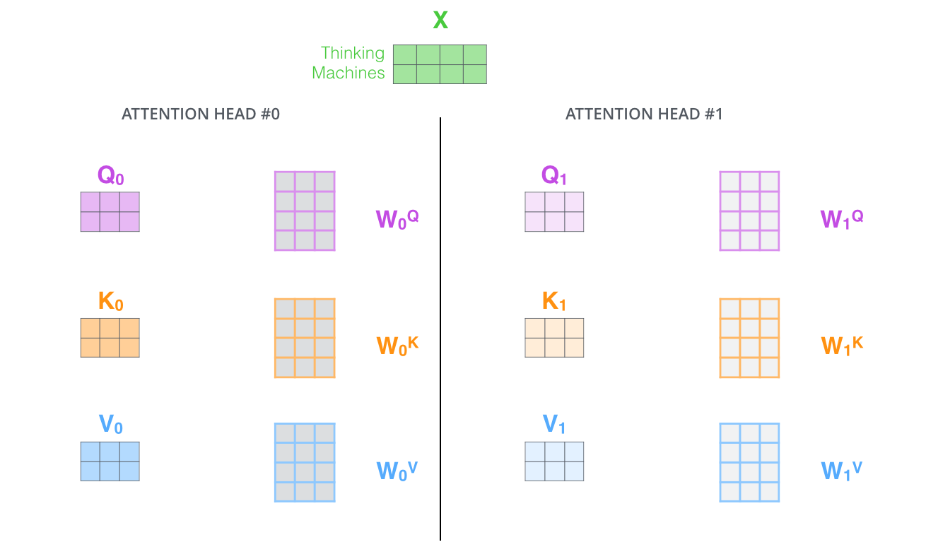
Multi-head self-attention
Transformers do not use only one attention mechanism – they use many simultaneously
With multiple attention heads at the same time, i.e., separate weight matrices for Q,K,V, to attend to other parts of the sequence in different ways (e.g., syntax, semantics…)
The basic transformer setup uses 6 encoder units and 6 decoder units, each with 8 self-attention heads
From Alammar (2018)

Slide 21
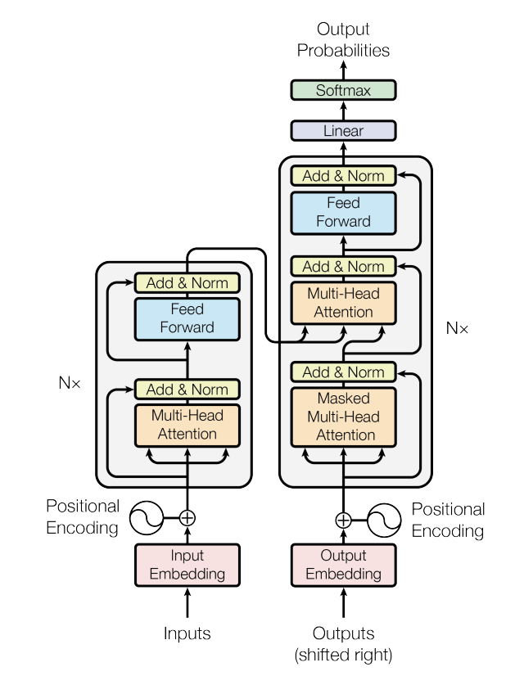
The transformer architecture
Self-attention is the basic building block of transformers
Transformers are made up of stacked transformer blocks, each of which involves attention and a few additional calculations
There are different types of transformers: encoder only (BERT), decoder only (GPT), and encoder-decoder (the original transformer, with both self and cross attention)

Slide 22
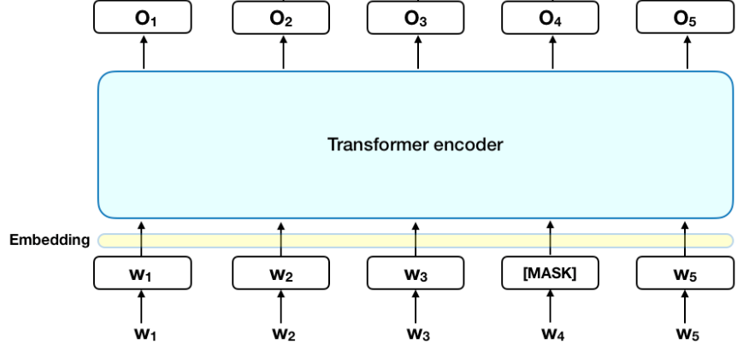
Meet BERT!
All of this is applied in BERT (Bidirectional Encoder Representations from Transformers, Devlin et al., 2019)
Encoder-only architecture with a series of stacked transformer block
Each block in the encoder has multiple attention heads, and it transforms the input of the previous block into a new representation (up to an output, O)
“Hierarchical” contextualization, capturing relations at different levels (e.g., role in the syntactic structure, semantic dependencies, etc)
Notes:
Several layers

Slide 23
How will this yields good representations?
Ok, this idea of contextualizing representations sounds cool: but do we make sure that the output vectors are meaningful and useful?
It all depends on the weights in self-attention layers (and of the embedding layer, and of FNNs in transformer blocks)
We use the good old idea of language modeling as a training task: we train our model to yield representations if tokens that can be used to predict what the contexts that surrounds them may be
We will mask a set of words/tokens, and try to guess which words/tokens they were leveraging information on the surrounding tokens
This is a particular version of language modeling, masked language modeling, but it is just a sophisticated version of what we were doing with CBOW Word2Vec
Notes:
Remember center / context words in word2vec?

Slide 24

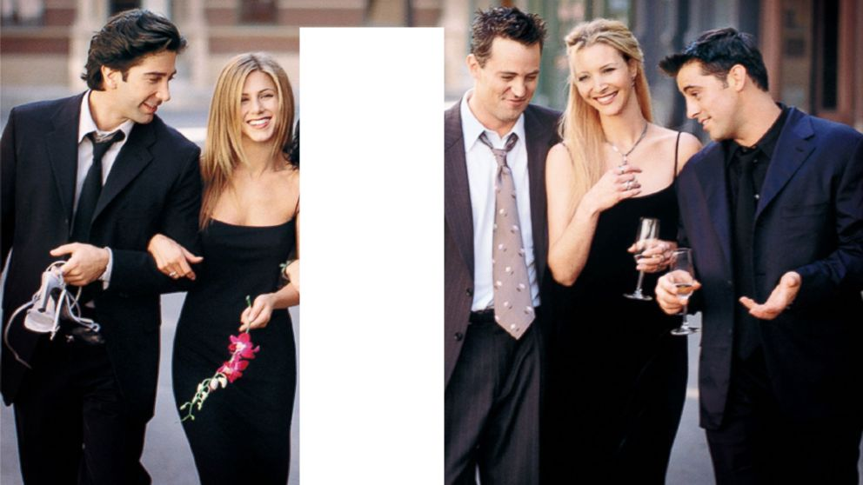
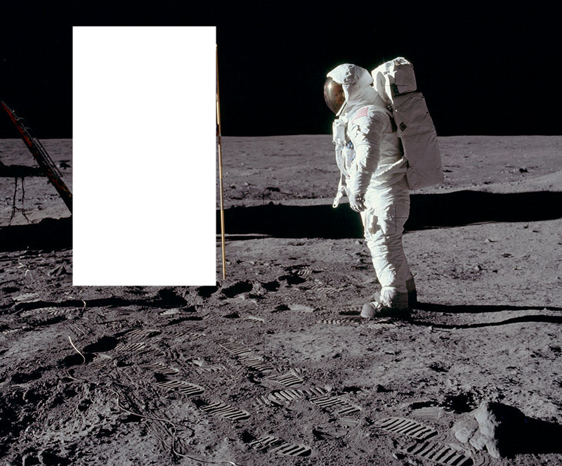
What’s in a mask?
Notes:
Remember center / context words in word2vec?

Slide 25
BERT training: input
Input to BERT always consists of one or two sentences (technically sequences)
[CLS] is added to the start of the first sequence
[SEP] is used to separate sequences and delimi the end of the sequence
We do sub-word WordPiece tokenization (Wu et al. 2016): ’playing’ -> ‘play’, ‘##ing’
Smaller vocabulary and deals well with out-of-vocabulary words

Slide 26
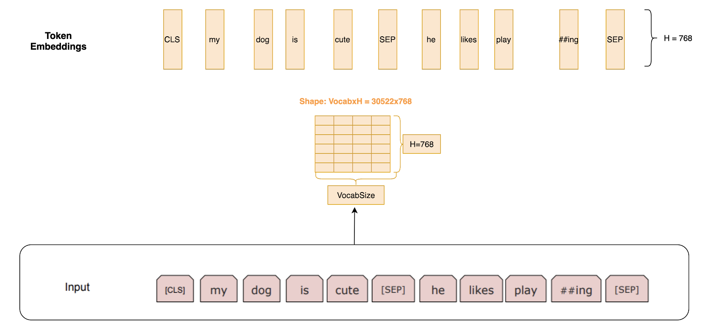
BERT training: embeddings
For each token, we look up a static embedding from a weight matrix (like in Word2Vec)
Note that these weights are updated over training

Slide 27
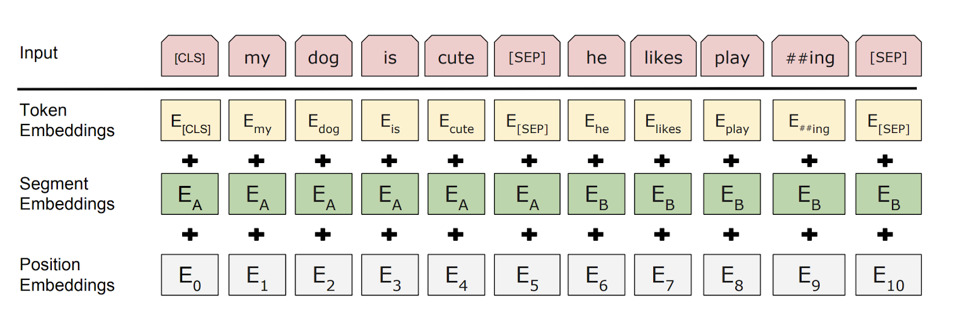
BERT training: augmenting input embeddings
We then augment these embeddings with a position embedding (Q: Why?) and a segment embedding
Position embeddings are learned and that encode the position in a sequence
There are two possible segment embeddings (first or second sentence)
So the final input passed to BERT is
(Wordpiece)Token Embeddings
+ Segment Embeddings
+ Position Embeddings
Notes:
Notion of order… ?

Slide 28
How does BERT learn?
BERT is optimized for two tasks simultaneously
Masked language modelling (MLM): reconstruct the missing word
Next sentence prediction (NSP): do the two sequences follow each other in the original corpus?
The rationale is the following:
MLM is language modeling: we know that language modeling is a good way to force a model to develop a number of linguistic skills
NSP is another proxy for linguistic knowledge which goes beyond word-level: it captures “higher-level” coherence and semantic understanding
In practice, NSP is hardly ever used beyond BERT
Notes:
We use the loss simultaneously

Slide 29
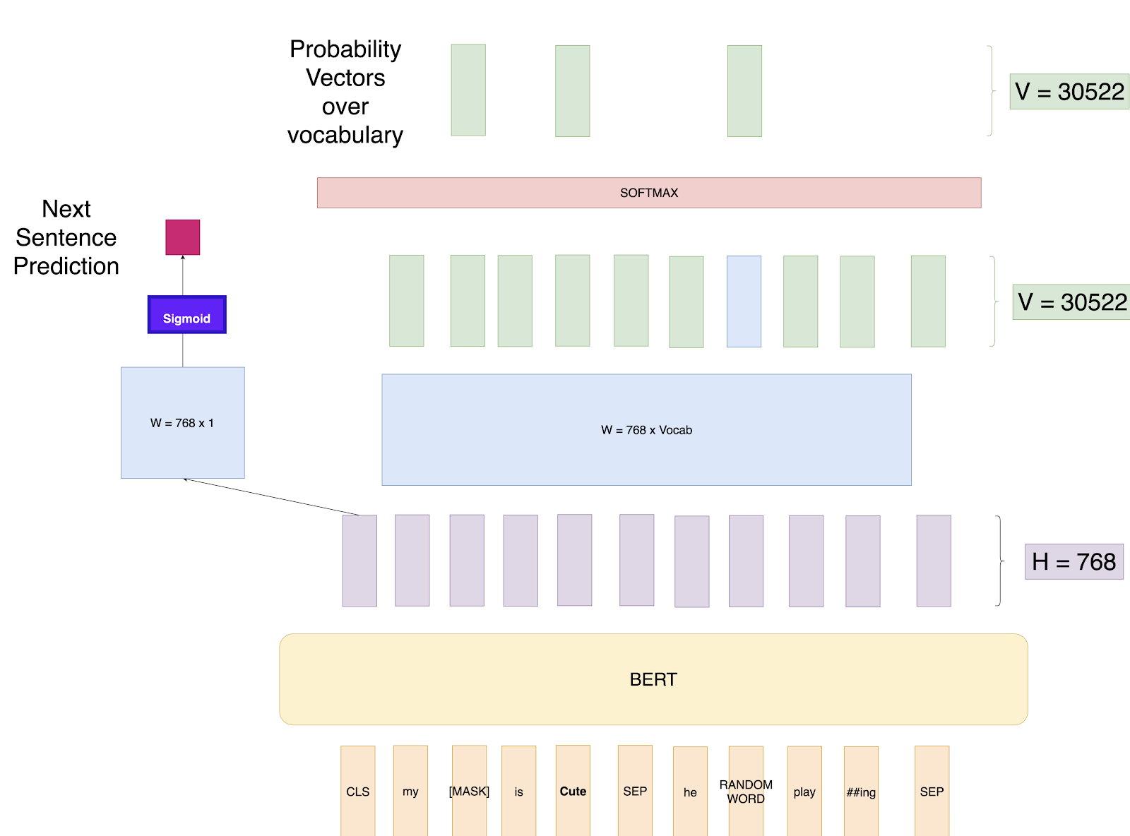
Masked language modeling
Let’s focus on MLM first: 15% of all tokens are masked, and we want to reconstruct the missing word from the final embedding of the [MASK] token
Usual trick: we feed the contextualized vector for the [MASK] tokens to a classification layer with softmax
During training, the loss (Q: which loss?) is calculated only over masked words
Notes:
— whiteboard time — (softmax([Tokens x 768 ] x [768 x vocab_size] )

Slide 30
What if we wanted to do forward language modeling?
Q: can we use the same logic to do forward language modeling on the whole sequence?
Notes:
NOTE: the [SEP] token is added to the end of the sequence!

Slide 31
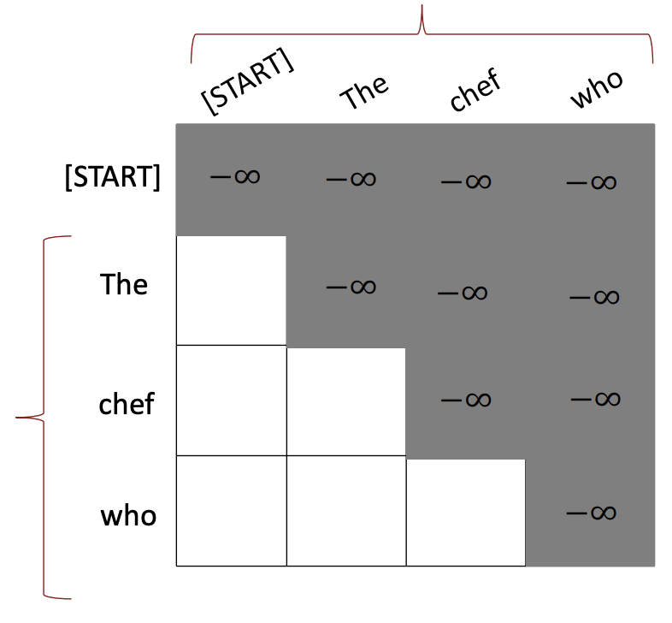
What if we wanted to do forward language modeling?
Q: can we use the same logic to do forward language modeling?
To prevent a model from accessing information in the future, we mask attention weights (before normalization) by setting weights for future tokens to -Inf
Plugging -Inf into a softmax yields weight zero
This allows the model to perform forward language modeling

Slide 32
Next sentence prediction
While creating the training data, we choose the sentences A and B for each training example
50% of the time B is the actual next sentence that follows A - labeled as IsNext; 50% of the time it is a random sentence from the corpus - labeled as NotNext
We then use the output encoding of the [CLS] token to predict the probability that the two sentences follow each other
BERT trains both MLM and NSP objectives simultaneously

Slide 33
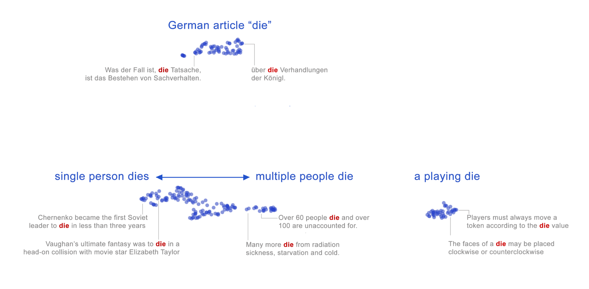
An example: contextualised embeddings
[Something we could not do with static embeddings, e.g., word2vec]
https://storage.googleapis.com/bert-wsd-vis/demo/index.html?#word=die
Coenen et al. (2019), Visualizing and Measuring the Geometry of BERT

Slide 34


Transfer learning with BERT
Through MLM and NSP pretraining BERT learns two things
Contextualized token-level representations
Sequence-level representations ([CLS])
They do reflect intrinsic properties of meaning
Are they good for downstream tasks?
So far, our approach to using language to perform downstream tasks (e.g., sequence classification) has been to use a model (e.g., Word2Vec) to extract encodings, then feed them to a new architecture
With BERT, we can swap the head (all layers above the transformer encoder output), introduce a new layer that fits our target task, and keep training the same architecture (potentially freezing some layers)
Notes:
Transformers have

Slide 35
Transfer learning with BERT
Our pretrained architecture already encodes a lot of useful information on language/meaning! It is just a matter of adapting it a bit to the new task (fine-tuning)
This approach, called transfer learning (and made possible with libraries for open-source sharing of pretrained models, such as HuggingFace’s libraries), outperforms by orders of magnitude all previous architectures on pretty much all downstream NLP tasks
This has made transformer ubiquitous in NLP
Notes:
Transformers have

Slide 36
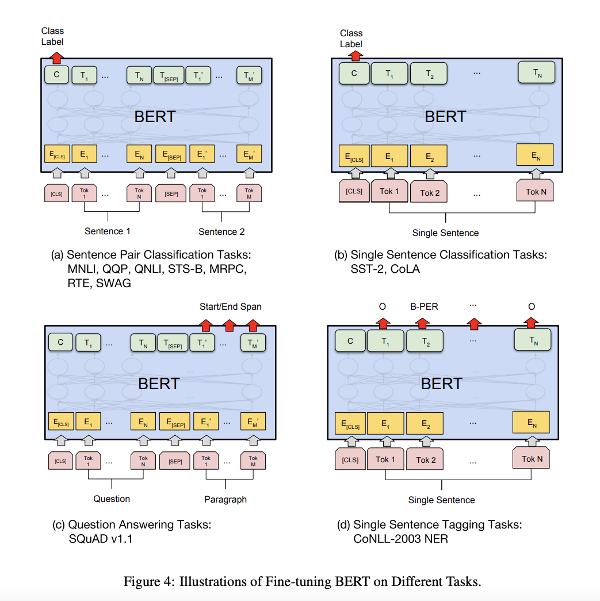
Fine tuning on NLP tasks
Sentence Pair Classification tasks
Linear + Softmax layer on top of the CLS output
Single Sentence Classification Task
Same
Question Answering Tasks
Given a question and a paragraph in which the answer lies. The objective is to determine the start and end span for the answer in the paragraph.
See also text summarization
Single Sentence Tagging Task
POS tagging, NER, etc. We just add a Linear layer of size (768 x n_outputs) and a softmax layer on top to predict

Slide 37
BERT as a black box
BERT did really, really well in a lot of tasks that previous models could not solve optimally
But what is happening inside BERT? What does BERT really learn through pretraining? How do its attention mechanisms really work? Do we need all of them? And is BERT biased?
Is BERT learning anything about semantics/syntax, or is it just a very sophisticated parrot?
Since the introduction of BERT, people have been trying to devise smart ways to “open the black box” and probe BERT’s internal mechanisms and knowledge
This literature is known as “BERTology”
Notes:
Machine translation is not trivial

Slide 38
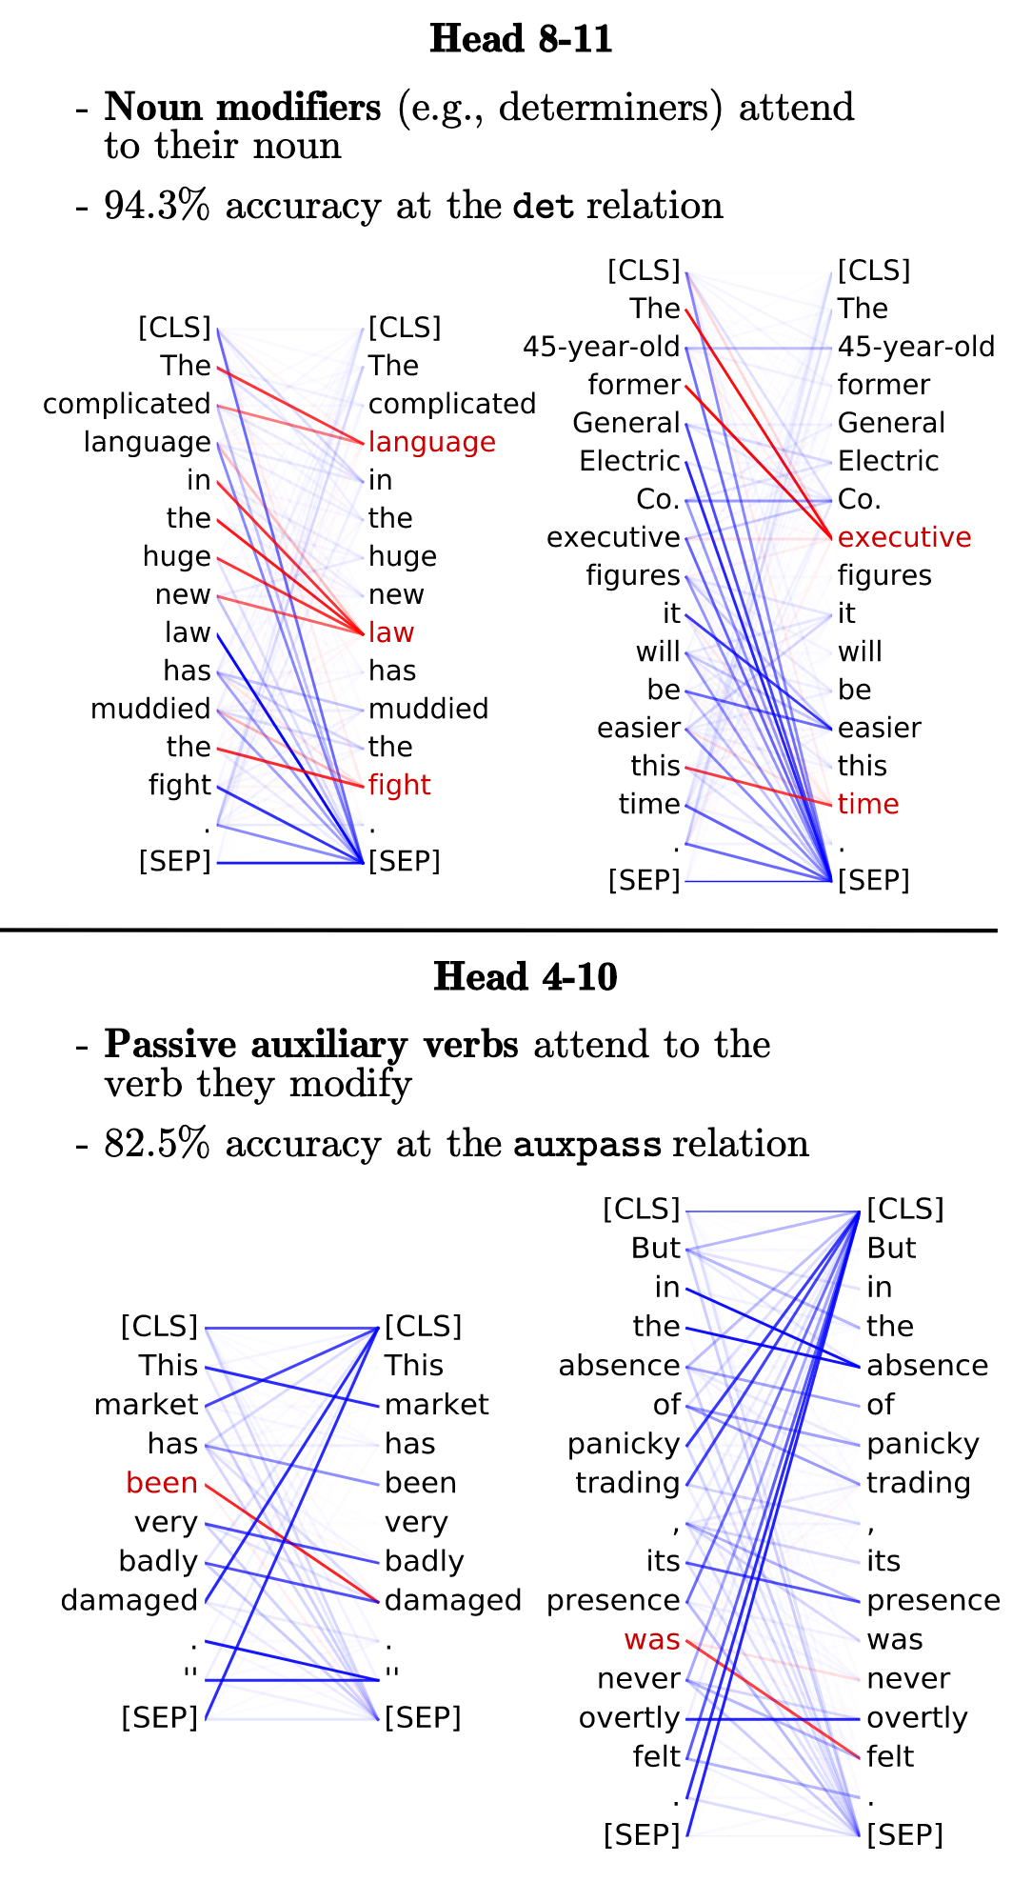
What is attention doing?
There seems to some evidence that specific attention heads model something about linguistic structure
We can see two examples to the right here taken from Clark et al (2019)
Head 8-11 (layer 8, head 11) seems to catch the relationship between noun phrases and their determiners
Head 4-10 captures passive auxiliary structures

Slide 39
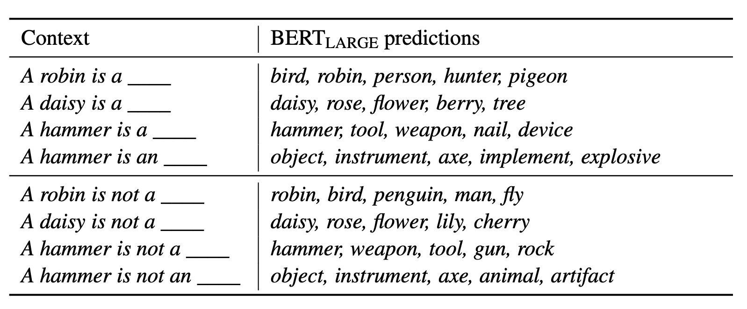
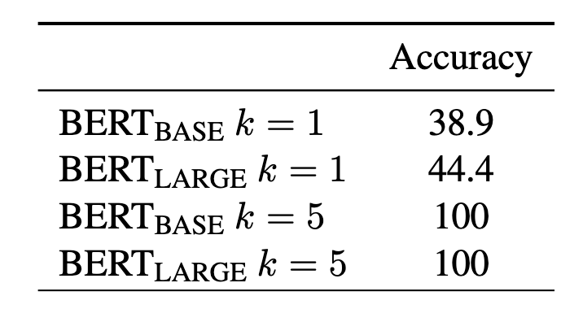
Psycholinguists tasks
Ettinger (2019) devised a series of diagnostic tests in order to see what specific linguistics capacities are learned by language models
These tests allow us to ask specific targeted questions about information used by LMs for generating predictions in context
Common-sense and pragmatic inference
Event knowledge and semantic roles
Negation

Slide 40
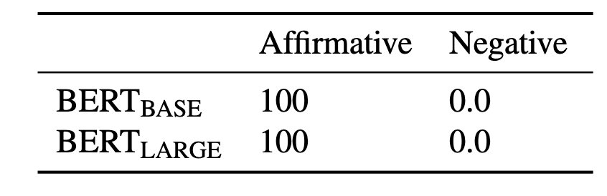
Psycholinguists tasks
BERT shows strong insensitivity to the meaning of negation, with preferring the category match every time

Slide 41
Summary
We have looked at how self-attention works in the context of a transformer, and which additional components a transformer block includes
BERT is a specific form of “encoder-only” transformer
Using stacked transformer blocks (whose core mechanisms is attention), BERT can yield contextualized representations of tokens and sequence-level representations at the same time
BERT is (pre)trained through two tasks: masked language modeling and next-sentence predictions
After learning weights through pretraining, the same architecture (minus the head, which is replaced with a new one) can be fine-tuned on specific tasks is known as transfer learning
This process, known as transfer learning, has revolutionized NLP
Notes:
Next time: looking at how transformers are used for language generation

Slide 42
See you tomorrow!

Slide 43
Additional reading
Blogs
Alammar, J. (2018). ‘The Illustrated Transformer’, https://jalammar.github.io/illustrated-transformer/
Karim, R. (2019). ‘Illustrated: Self-Attention’, https://towardsdatascience.com/illustrated-self-attention-2d627e33b20a
Kazemnejad, A. (2019). ‘Transformer Architecture: The Positional Encoding’, https://kazemnejad.com/blog/transformer_architecture_positional_encoding/
Weng, L. (2018). ‘Attention? Attention!’, https://lilianweng.github.io/lil-log/2018/06/24/attention-attention.html

Slide 44
Additional reading
Scientific articles
Clark, K., Khandelwal, U., Levy, O., & Manning, C.D. (2019). ‘What does BERT look at? An analysis of BERT’s attention’, Proceedings of the Second BlackboxNLP Workshop on Analyzing and Interpreting Neural Networks for NLP, pp. 276–286.
Coenen, A., Reif, E., Yuan, A., Kim, B., Pearce, A., Viégas, F., & Watttenberg, M. (2019). ‘Visualising and measuring the geometry of BERT’, 33rd Conference on Neural Information Processing Systems.
Kovaleva, O., Romanov, A., Rogers, A., & Rumshisky, A. (2019). ‘Revealing the Dark Secrets of BERT’, Proceedings of the 2019 Conference on Empirical Methods in Natural Language Processing and the 9th International Joint Conference on Natural Language Processing, pp. 4365-4374.
Vig, J., Madani, A., Varshney, L.R., Xiong, C., Socher, R., & Rajani, N.F. (2021). ‘BERTology meets biology: Interpreting attention in protein language models’, International Conference on Learning Representations.
Wu, Y. et al. (2016). “Google's Neural Machine Translation System: Bridging the Gap between Human and Machine Translation”, arXiv, https://doi.org/10.48550/arxiv.1609.08144
Blog on the WordPiece tokenization algorithm in HuggingFace
https://huggingface.co/course/chapter6/6?fw=pt

